Slide 1
Development of CAM systems for incremental forming from 3D CAD data
3D CADデータからの増分成形用CAMシステムの開発
By: Karter Wong
A2177802
Notes:
Hello. My name is Karter Wong, and I will present my research project on the development of a CAM system for incremental forming from 3D CAD data.

Slide 2
Introduction
Progress
Future steps
Notes:
I will first introduce the topic, show my progress, and discuss the next steps for next semester.

Slide 3
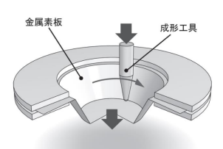
Introduction
Development of the CAM system for incremental forming from 3D CAD data
3D CADデータからのインクリメンタル成形用CAMシステムの開発
Notes:
As I mentioned at the beginning of the presentation, my research topic is the development of CAM systems for incremental forming from 3D CAD data. My research project is based on Mitsumori Senpai’s research paper, which showcased a CAM system modeling and machining a truncated cone by converting STL data into G-code. My goal for this project is to make a CAM system that could model a bit more complex shapes, and the test shape I used was a dome with a square base as you will see later.

Slide 4
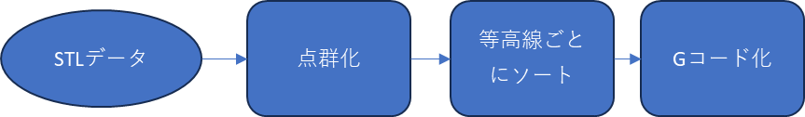
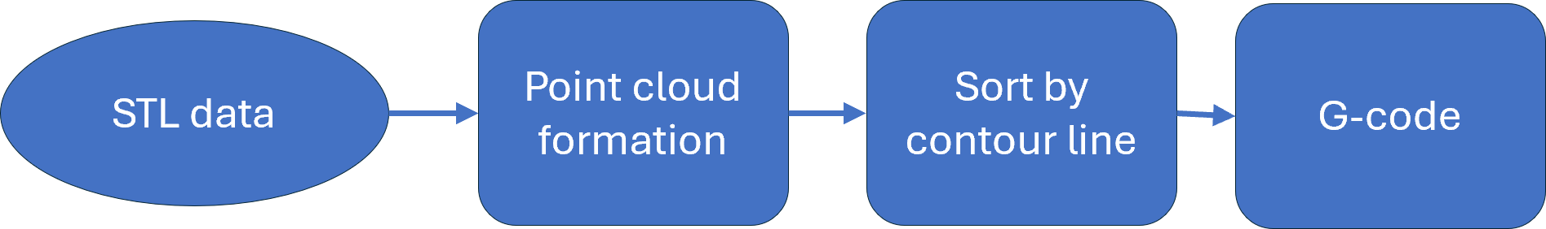
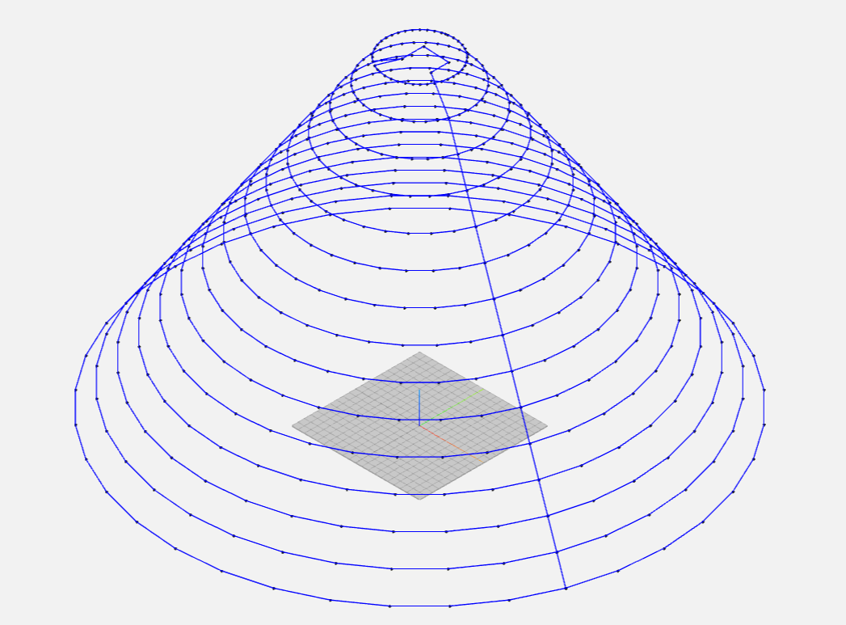
Mitsumori senpai’s
Flow chart
Notes:
The CAM system from Mitsumori Senpai’s research can be broken into four simple steps: 1, taking the STL data from the STL file from the modeling software of your choice. 2, convert that data to a point cloud, which is all the corners of the triangles from the STL data. 3, sort the points by contour lines or the Z coordinate and nearest points . And 4, convert the sorted points into G-code.
This semester, I further developed this program to have a few more steps to improve the CAM system.

Slide 5
My Flow chart
Program start
Calculating TSP
Sorting the points in a clockwise direction
If the shape is circular the program uses the circular processing module
Converting the toolpath to G-code
If the shape is not circular the program uses the noncircular processing module
Is the shape mostly circular?
プログラムの開始
TSPの計算
ポイントを時計回りに並べ替える
形はほぼ円形でしょうか？
形状が円形の場合、プログラムは円形処理モジュールを使用します。
形状が円形でない場合、プログラムは非円形処理モジュールを使用します。
ツールパスを G コードに変換する
Notes:
My code starts by also taking the STL data and converting it to a point cloud; it identifies the variables that you set, like the number of layers you want your shape to have or the tolerance on how big the distance between the layers should be, which is represented by the program start section. Next, the program starts calculating the toolpath by using the Traveling salesperson method, essentially ensuring that the toolpath always moves to the closest point on the layer and then sorts those points so that the toolpath moves in a clockwise direction, ensuring a smooth toolpath. Then, it detects if a layer is circular or noncircular and determines which method to use to process the points.
After the program generates a tool path, it converts it to G-code and adds the general parameters for G-code, such as Absolute positioning (G90) and end program (M30).
*TSP is a programming optimization problem to find the shortest path that connects a given set of points.

Slide 6
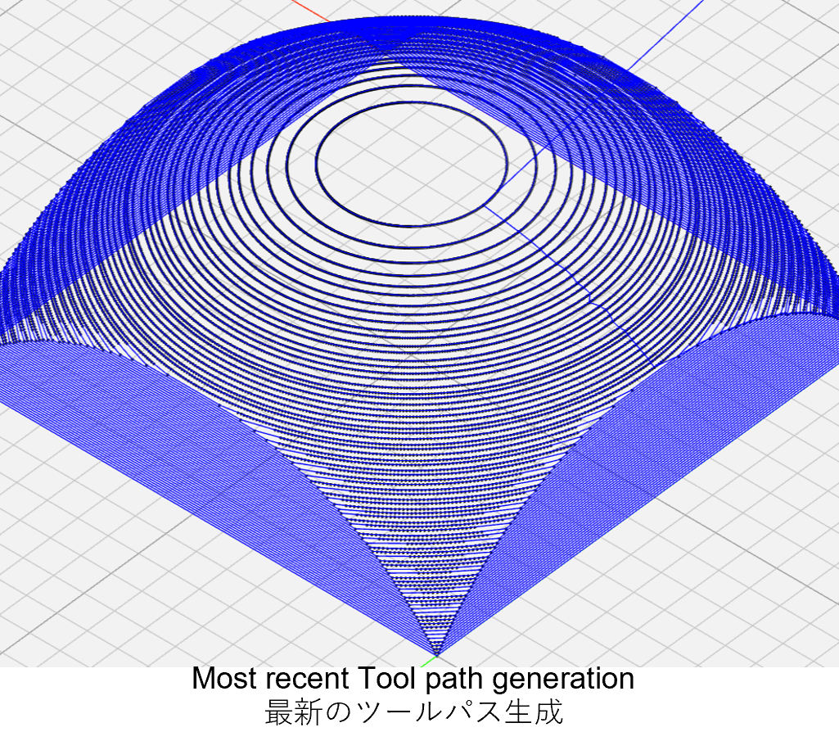
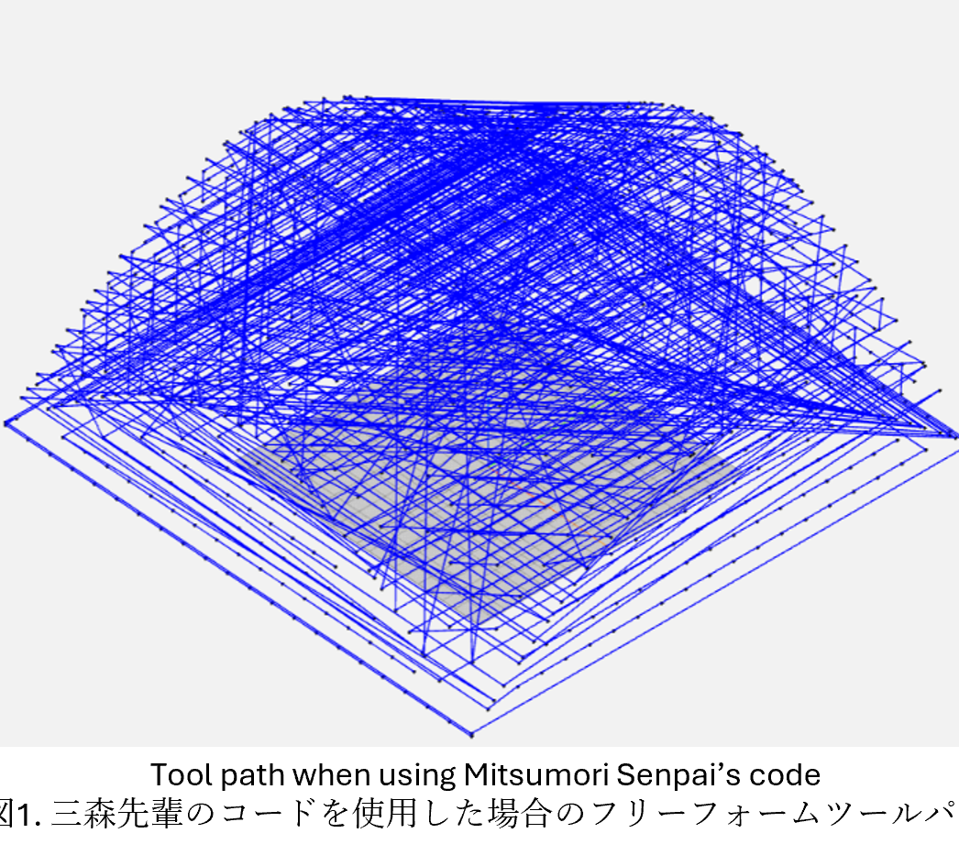
Features of the Toolpath Generation
  Rounding
  丸め
  TSP
  Convexhull
  凸包
  Adjustable variables
  調整可能な変数
Notes:
The following functions allow the Toolpath to generate shapes like the ones you see here: rounding, TSP, Convexhull, and adjustable variables. These features are essential to the clear that you see at the top right corner. The rounding groups the layers to the nearest number you wish and eliminates redundant points. The TSP ensures that all the points on a layer are “reached” in order. Convexhull ensures that the outermost points are the only points used in the generation of the tool path, and adjustable variables allow you to have as much details as you want. Without these functions you would get something like the bottom right figure.

Slide 7
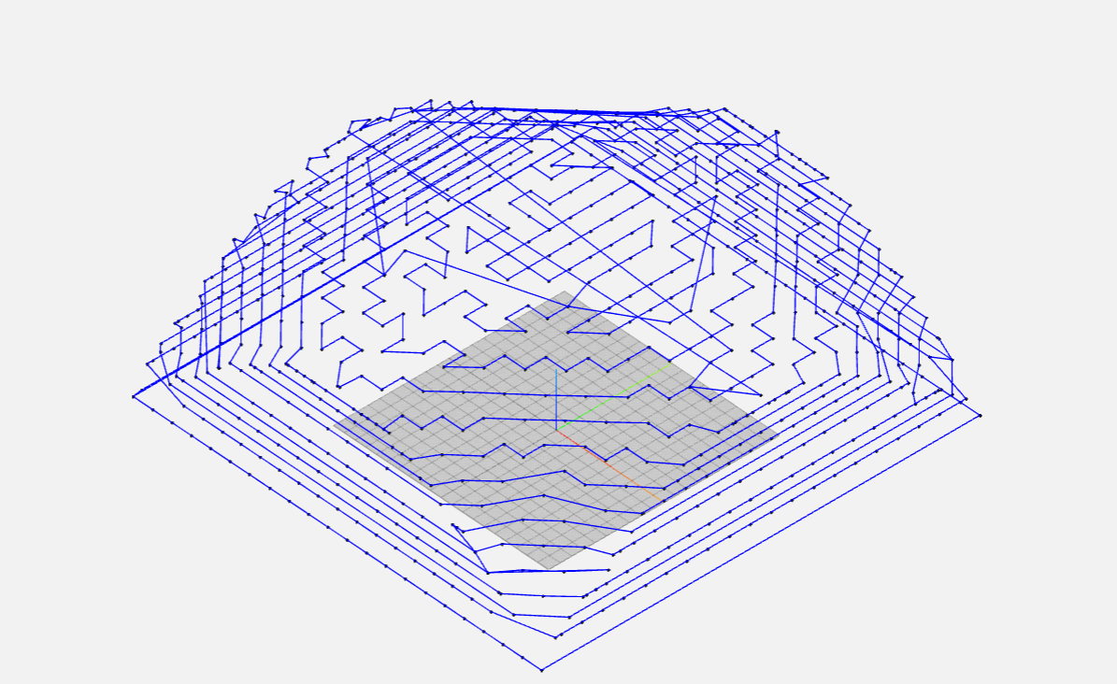
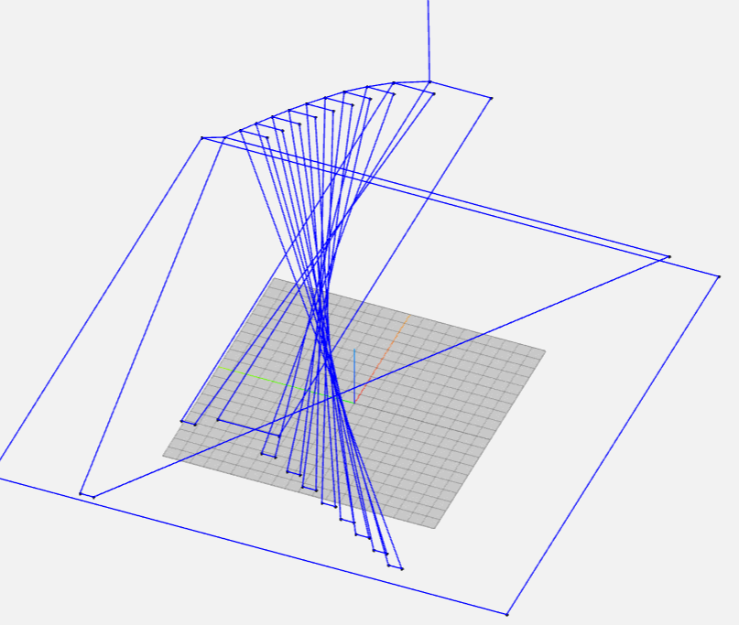
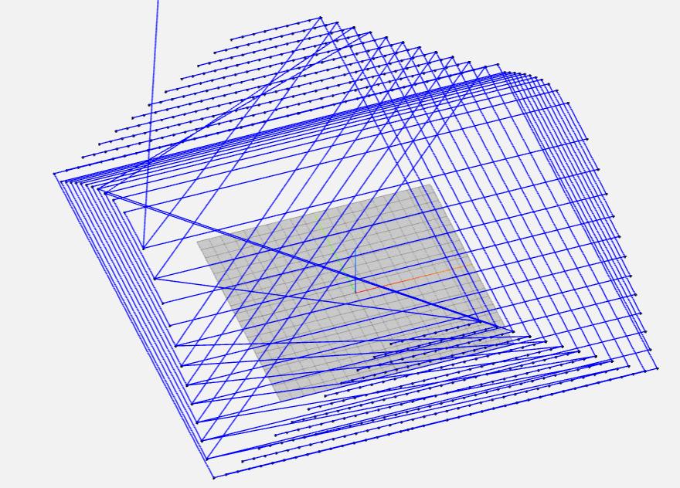
Without the features
Without convex hull
凸包なし
Without setting the variable for the distance between layers
層間の距離の変数を設定せずに
Without rounding
四捨五入なし
Notes:
This slide just shows what the toolpath would look like without the, Convexhull, rounding, and the variables.

Slide 8
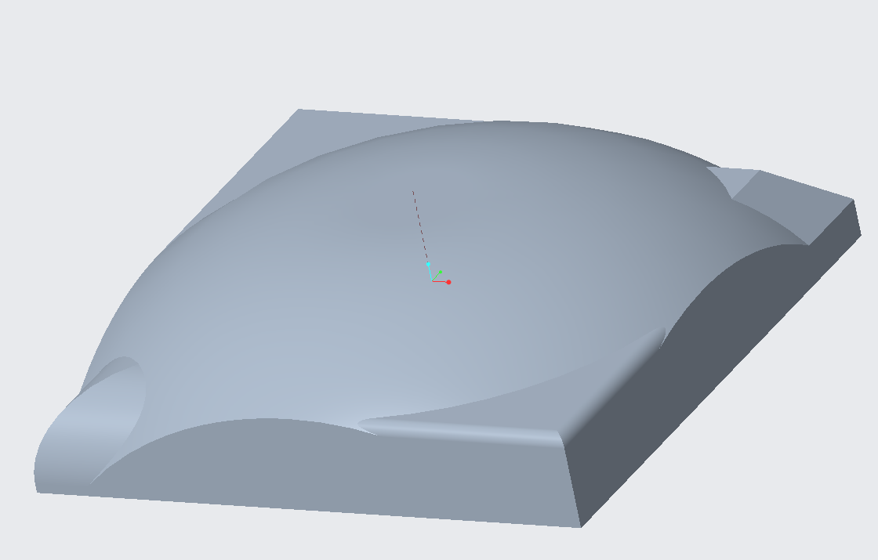
Future steps
Producing a mold and conducting experiments so to create a free form shape
Improving the strength of the free form shapes
型を製作し、実験を行い、自由形状を作成します
自由形状の強度を向上させます
Notes:
Next semester, I aim to start conducting experiments to see if making these shapes is possible and make the necessary adjustments. After that, I aim to find ways to improve the strength of the shape that is produced. My goal for my final presentation for my graduation thesis is to produce a more complex-looking shape, like this one.

Slide 9
Any Questions?
Notes:
Any questions?

Slide 10
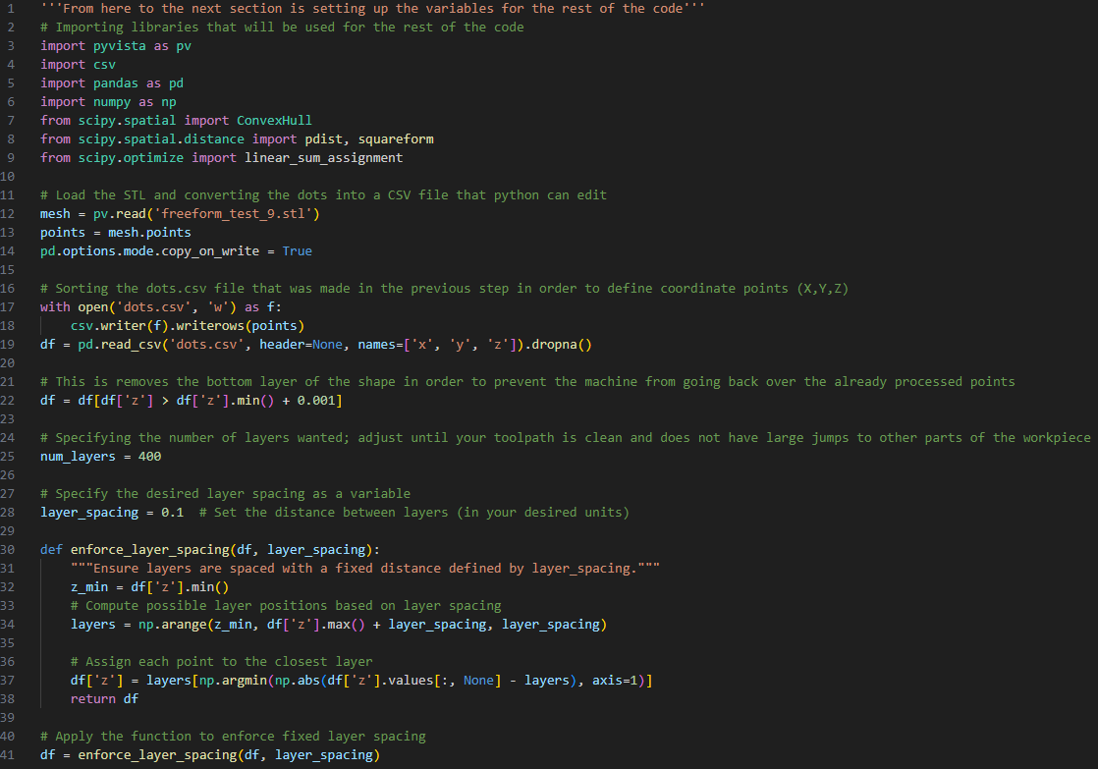
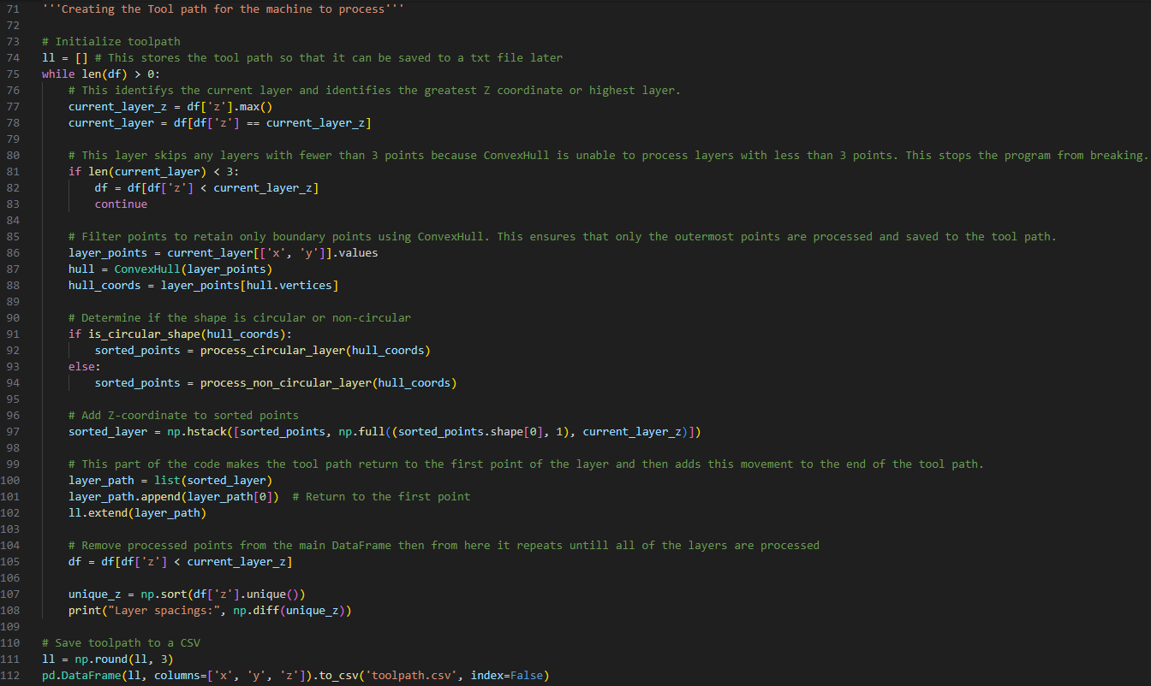
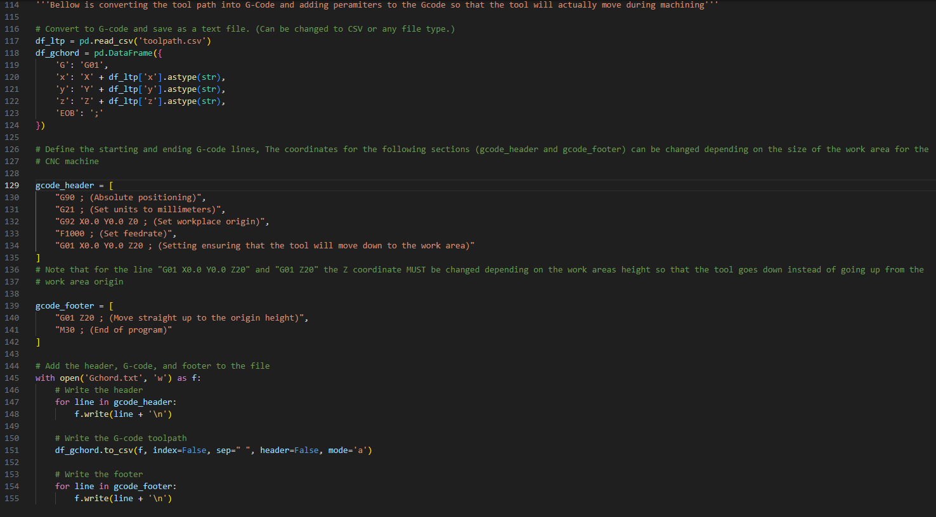
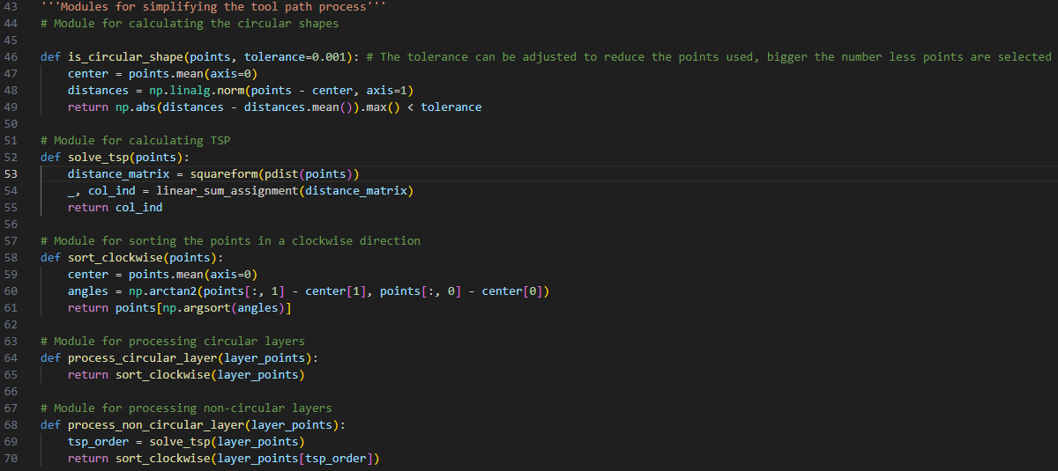
Tool path generation
Program start
G-code translation

Slide 11
References
Guttag, J. V. (2021). Introduction to computation and programming using Python: With application to computational modeling and Understanding Data. The MIT Press.
H. Tanaka, K. Yamada, and T. Ikari, “Feasibility Study of Laser-Assisted Incremental Forming for Carbon Fiber Reinforced Thermo Plastic Based on 3D-CAD Data,” Int. J. Automation Technol., Vol.17 No.2, pp. 144-155, 2023.
Mitsumori, T. (2023). CFRTP incremental forming under hot water conditions using an oil bath and CAM system creation using Python language.
Sharma, V., Sharma, V., & Shukla, O. J. (n.d.). Principles and practices of CAD. Chapman and Hall.
Simpson, A. (2024). Python all-in-one for dummies. John Wiley & Sons, Incorporated.
T. Ikari and H. Tanaka, “Feasibility Study of Single-Point Incremental Forming for Discontinuous-Fiber CFRP Using Oil-Bath Heating,” Int. J. Automation Technol., Vol.18 No.3, pp. 433-443, 2024.
Notes:
Here are my references.

Slide 12
Introduction-What is incremental forming and discontinuous CFRTP
Incremental forming is the process of processing without the need of a mold to create high strength molded products.
Due to discontinuous CFRTP’s properties such as recyclability, and ability to hold a shape after being molded, it was selected as the test material.
Notes:
My research’s goal is to improve the CAM system to allow incremental forming to be done for
Incremental forming is the he process of processing without the need of a mold to create high strength molded products.
Due to discontinuous CFRTP’s properties such as recyclability, and ability to hold a shape after being molded, it was selected as the test material.

